Slide 1
Low-dimensional Neuron Models
BT6270: Introduction to Computational Neuroscience

Slide 2
Single Neuron Modeling
Biophysical Modeling
Dendritic Processing
Axonal Processing
Synaptic Transmission
More
Detailed
Action Potential
generation
Hodgkin-Huxley Model
Simplified Neuron Models
FitzHugh-Nagumo model
Morris-Lecar Model
Izhikevich Models
Integrate and fire neuron
McCulloch-Pitts neuron
Less
Detailed

Slide 3
Single Neuron Modeling
Biophysical Modeling
Dendritic Processing
Axonal Processing
Synaptic Transmission
More
Detailed
Action Potential
generation
Hodgkin-Huxley Model
Simplified Neuron Models
FitzHugh-Nagumo model
Morris-Lecar Model
Izhikevich Models
Integrate and fire neuron
McCulloch-Pitts neuron
Less
Detailed

Slide 4
HH model is the earliest model of action potential (AP) generation in an axon.
It shows how voltage-sensitive dynamics of sodium and potassium channels results in generation of APs.
But real neurons have a much larger variety of ion channels. There are dozens of voltage- and Ca2+-gated channels known today.

Slide 5
Combinations of these channels can give rise to an astronomically large number of neuron models.
Even the HH model, the simplest model of AP generation that we encountered so far, has 4 nonlinear differential equations
More realistic neuron models with larger number of ion channels can easily become mathematically intractable.

Slide 6
It would be desirable to construct simplified models, with fewer variables, and milder nonlinearities, in such a way that the reduced model preserves the essential dynamics of their more complex versions.
One of the first reduced model of that kind is the FitzHugh-Nagumo neuron model.

Slide 7
FitzHugh-Nagumo
FitzHugh-Nagumo model is a two-variable neuron model, constructed by reducing the 4-variable HH model, by applying suitable assumptions.

Slide 8
Hodgkin- Huxley model is described by the following equations:

Slide 9
Assumptions
The time scales for m, h and n variables are not all of the same order.
These disparities provide a basis for eliminating some of the gating variables.

Slide 10
Since the time scale for m is much smaller than that of the other two, we assume that m relaxes faster than the other two gating variables. Therefore, we get,
--- (1)

Slide 11
The variable h in the Hodgkin Huxley model varies too slowly.
Therefore, we let h to be a constant, h = h₀
The resulting system has only two variables (v, n)

Slide 12
After transformation to dimensionless variables, and some approximations, the resulting FN model may be defined as,
--- (2)
--- (2.a)
--- (3)

Slide 13
In the above system, v is analogous to the membrane voltage, and w represents all the three gating variables.

Slide 14
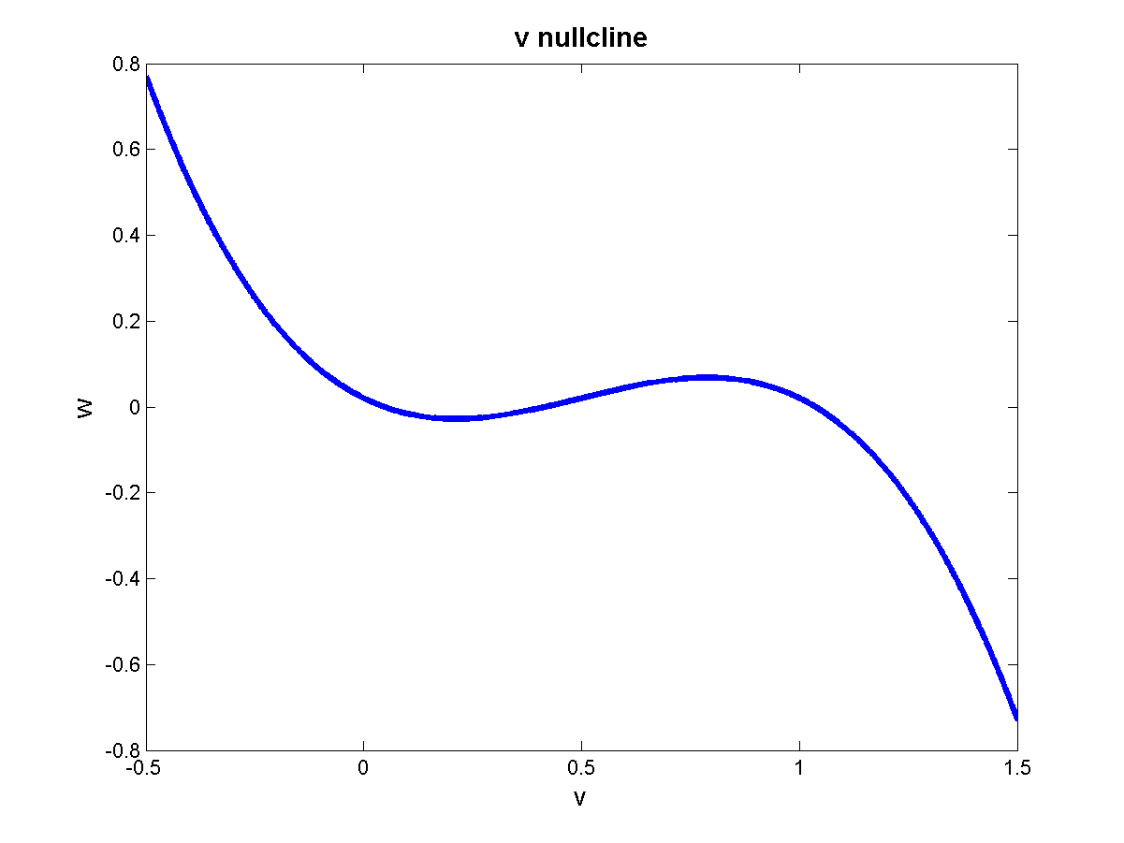
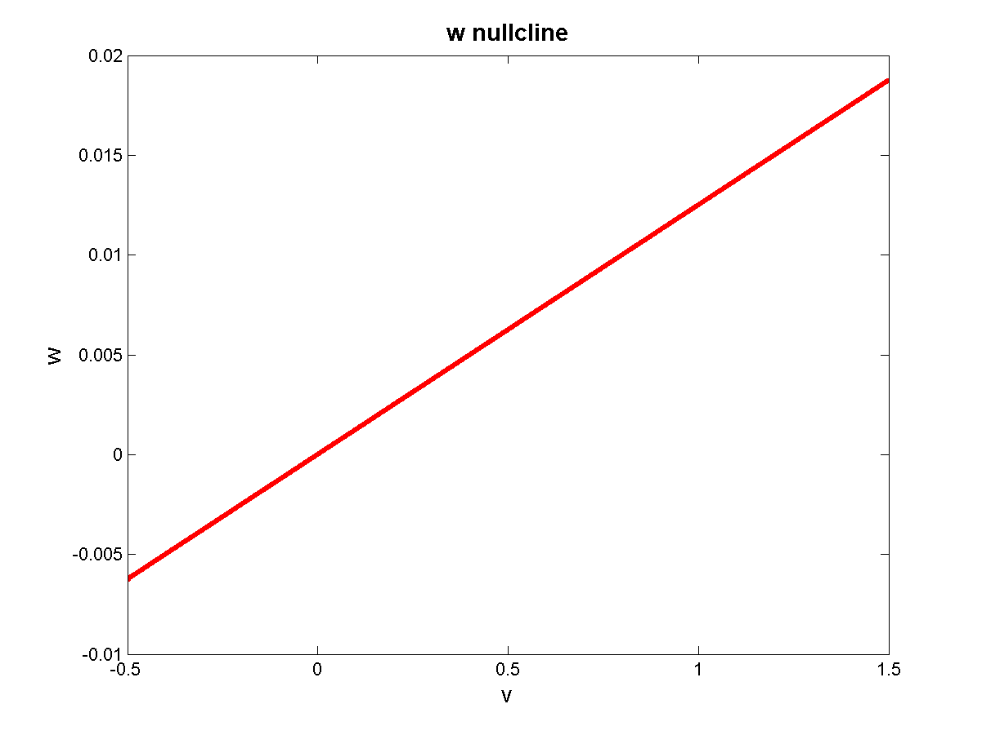
The two nullclines of the above system are,
(F-nullcline)
(g-nullcline)
(F-nullcline)
(g-nullcline)

Slide 15

To examine the stability of a stationary point, we calculate the Jacobian, A, of the system at that point.
The determinant and the trace are given as:
=
$$Δ=f^{′}\left(v\right)\left(−r\right)+b$$

Slide 16
The type of the stationary point can be expressed in terms of determinant, Δ, and trace, τ, of the Jacobian, using the following rules:
If Δ < 0, the stationary point is a saddle irrespective of the value of τ .

Slide 17
If Δ > 0, τ < 0, stable fixed point
Assume 0< b, r <<1.
That is, Δ > 0, when the slope of the f-nullcline is less than slope of w-nullcline.

Slide 18
If Δ > 0, τ > 0, unstable fixed point.
Now let us consider the behavior of FN model as external current I_{a} is gradually increased.

Slide 19
I_{a} =0, Excitability
The phase-plane shown below depicts the situation when I_{a} =0. There is only one stationary point at the origin.
Stability of origin:
Slope of F-nullcline > slope of w-nullcline
Slope of F-nullcline < 0
Δ > 0
Origin is a Stable fixed point

Slide 20
Consider the evolution of the variable v (membrane voltage) when the initial condition is at points p₁ or p₂
Initial voltages

Slide 21
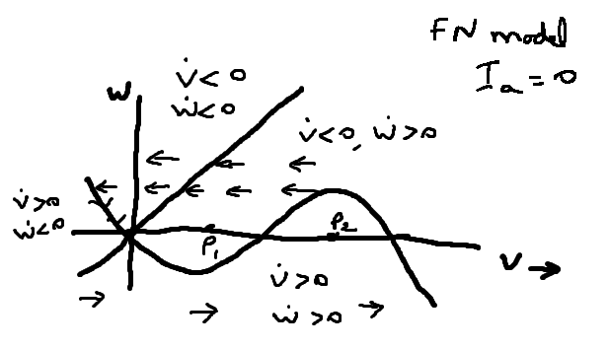

Slide 22
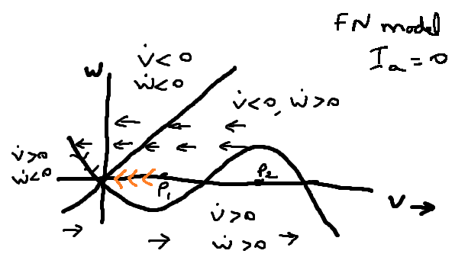
For 0 < p1 < a

Slide 23
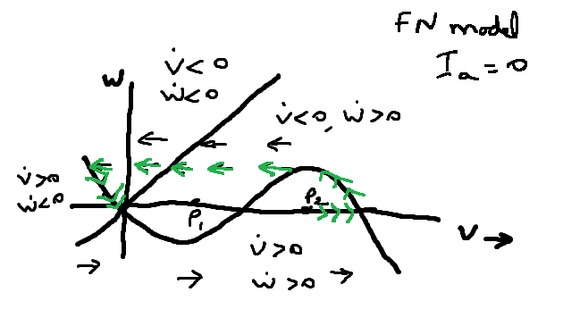

Slide 24
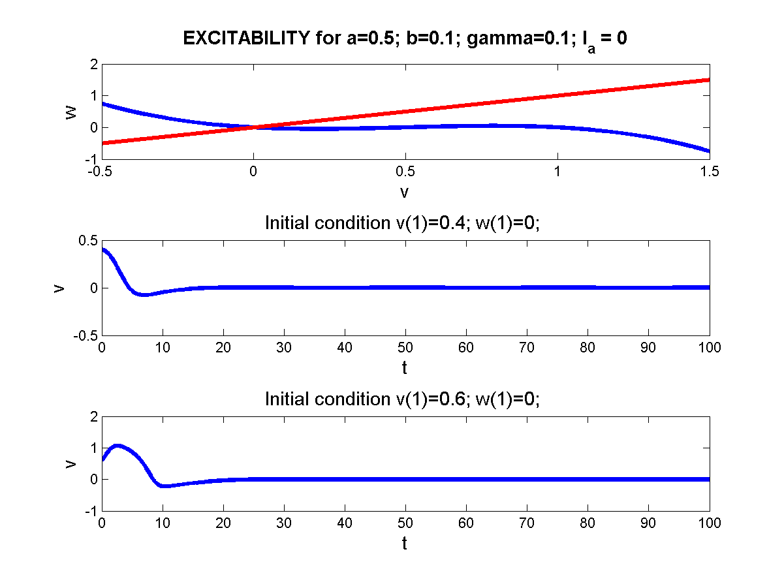

Slide 25
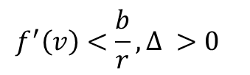
Limit Cycles (I_{a} > 0):
As increases, for a range of values of , the w-nullcline intersections the F-nullcline in the “middle branch” where the F-nullcline has a positive slope. In this case too there only a single intersection.
Therefore, the stationary point is unstable
$$f^{′}\left(v\right)<\frac{b}{r}, Δ >0$$

Slide 26
The rough ‘arrow plot’ shows that there is a ‘circulating field’ around the stationary point, which is unstable.
Thus it can be expected that there is a limit cycle enclosing the stationary point, which is actually true.

Slide 27
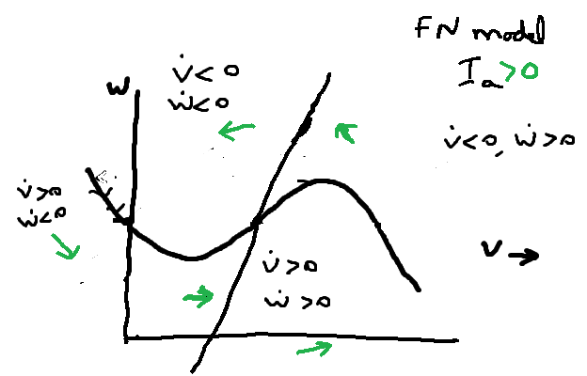

Slide 28
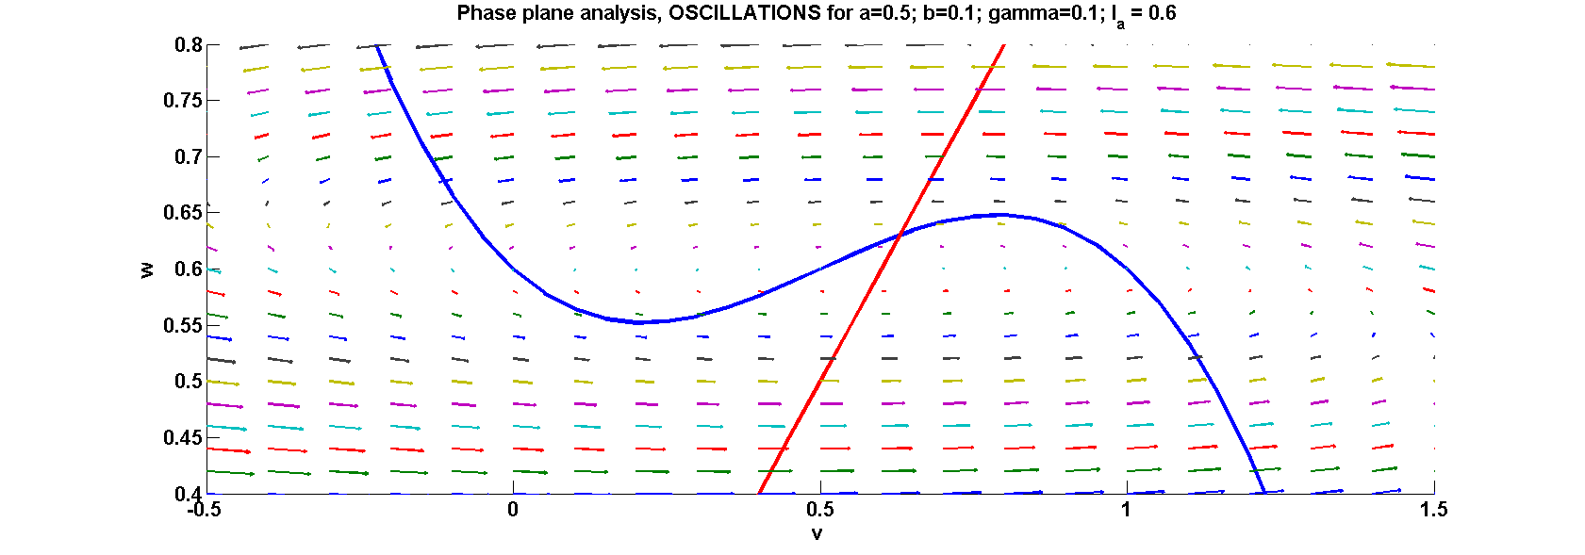

Slide 29
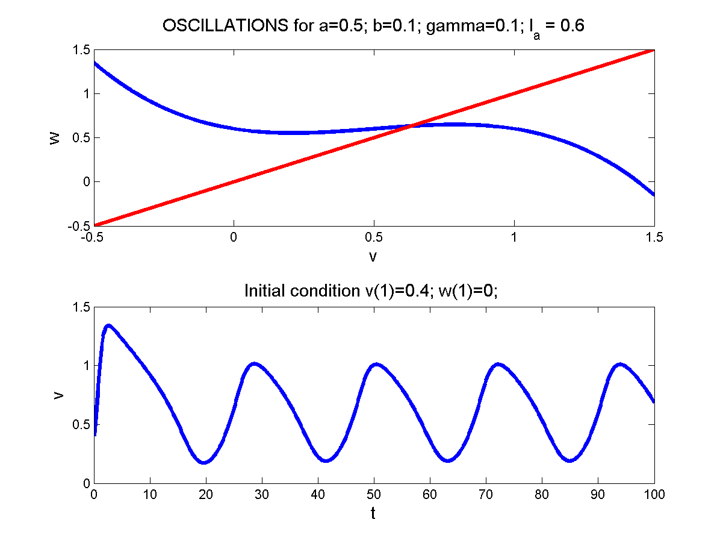
The figure shows the oscillations in membrane voltage (v) produced by a MATLAB program

Slide 30
Depolarization (higher I_{a}):
As increases further, the two nullclines intersect in the “right branch” of the F-nullcline where the slope of F-nullcline is negative.

Slide 31
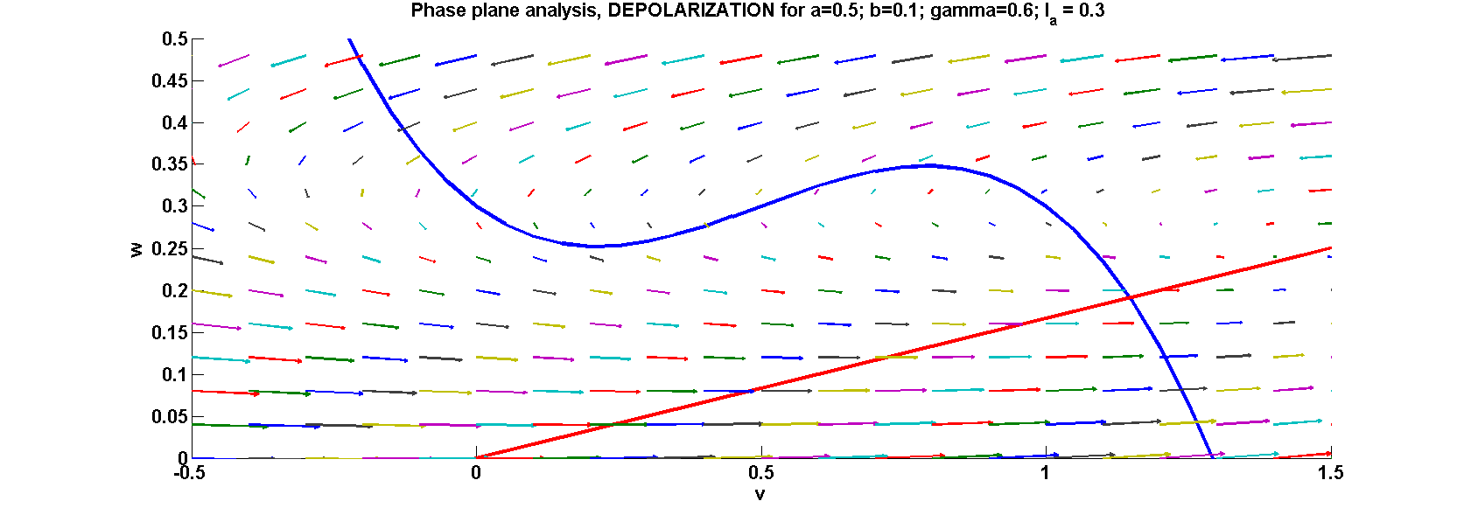

Slide 32

We know that the stationary point is stable.
In this case, the membrane voltage remains stable at a high value. This corresponds to regime 4 in the HH model where for a sufficiently high current, the neuron does not fire but remains tonically depolarized.
$$f^{′}\left(v\right)<0<\frac{b}{r}, Δ >0$$
$$τ=f^{′}\left(v\right)<0, stable$$

Slide 33
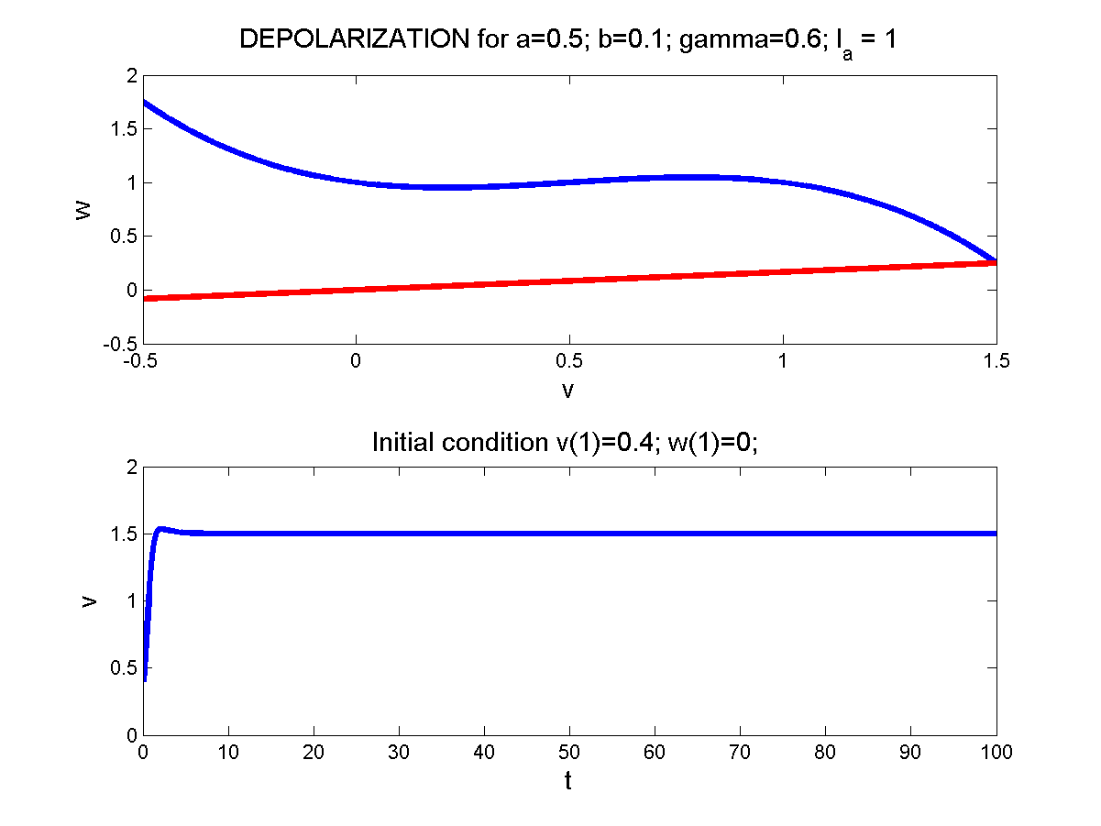

Slide 34
Bi-stability
Some real neurons exhibit bistable behavior – their membrane voltage can remain at tonically high (“UP” state) or tonically low (“DOWN” state) values. These UP/DOWN neurons are found in striatum and prefrontal cortex.
The FN model exhibits bistability for a certain range of model parameters.

Slide 35
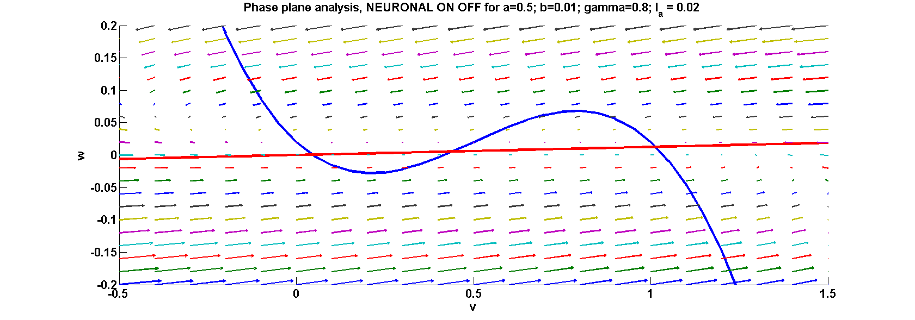

Slide 36
The figure shows a configuration in which the null-clines intersect at three points (p₁, p₂ and p₃).
It can easily be shown that p₁ and p₃ are stable, and p₂ is a saddle.

Slide 37



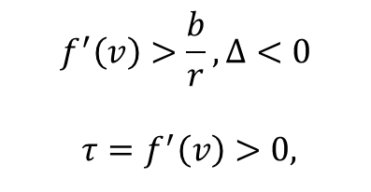
@ p₁:
@ p₂ :
@ p₃ :
$$f^{′}\left(v\right)<0<\frac{b}{r}, Δ >0$$
$$τ=f^{′}\left(v\right)<0, stable$$
$$f^{′}\left(v\right)>\frac{b}{r}, Δ<0$$
$$τ=f^{′}\left(v\right)>0,$$
$$saddle node$$
$$f^{′}\left(v\right)<0<\frac{b}{r}, Δ >0$$
$$τ=f^{′}\left(v\right)<0, stable$$

Slide 38
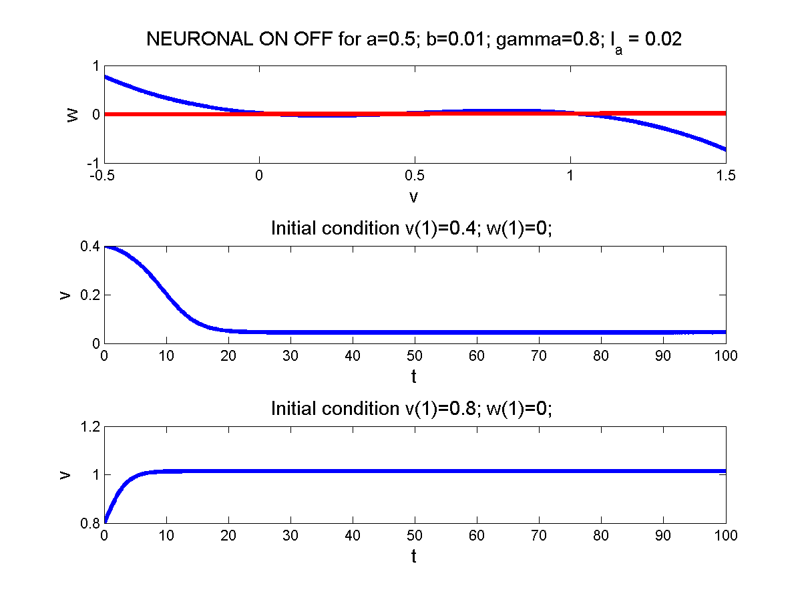

Slide 39
FN model in this case, can remain stable at either p1(low v value, DOWN state) or at p3 (high v value, UP state).

Slide 40
Morris-Lecar model
The Morris-Lecar (ML) model (Morris and Lecar 1981) describes the membrane voltage dynamics of the barnacle muscle fiber. It consists of three channel currents:
A fast activating Ca2+ current (activating variable – m)
A delayed rectifying K+ current (activating variable – w)
A leakage current

Slide 41
Simplifying Assumption:
As in the case of FN model, we assume that the dynamics of m-variable is fast.
Therefore, m may be substituted by .

Slide 42
Equations of the ML model are given as,

Slide 43
where;

Slide 44
v-nullcline:
w-nullcline:

Slide 45
Note that the v-nullcline is ‘inverted N’-shaped, similar to the F-nullcline of FN model.
The w-nullcline has a sigmoidal shape.
The v-nullcine can be divided into ‘left’, ‘middle’ and ‘right’ branches.

Slide 46


Depending on the branch in which the intersection of V- and w-nullclines, we have different dynamics.
The v-nullcine rises with increasing I_{a}.

Slide 47
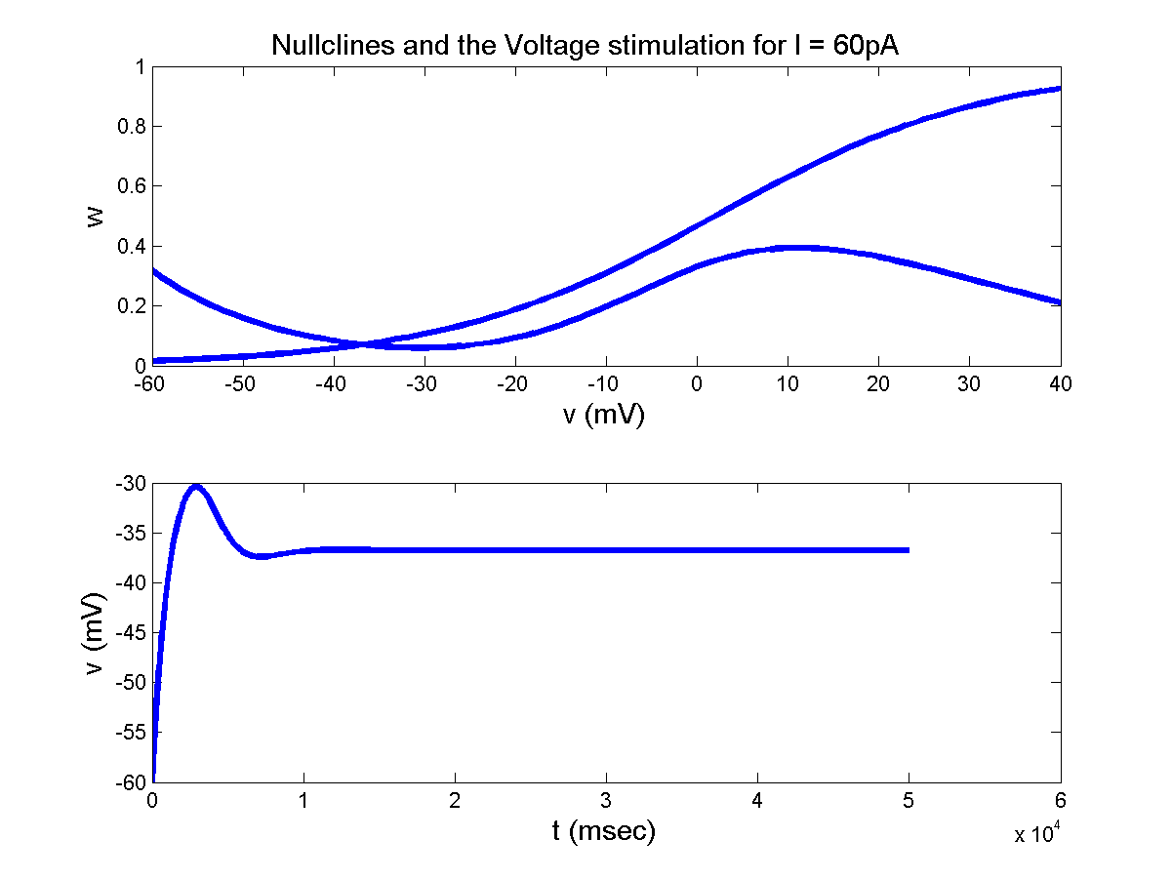
For I_{a} in the range (0-68 pA): the intersection point is in the left branch. The point can be shown to be stable.
Therefore, the ML model does not produce spikes

Slide 48
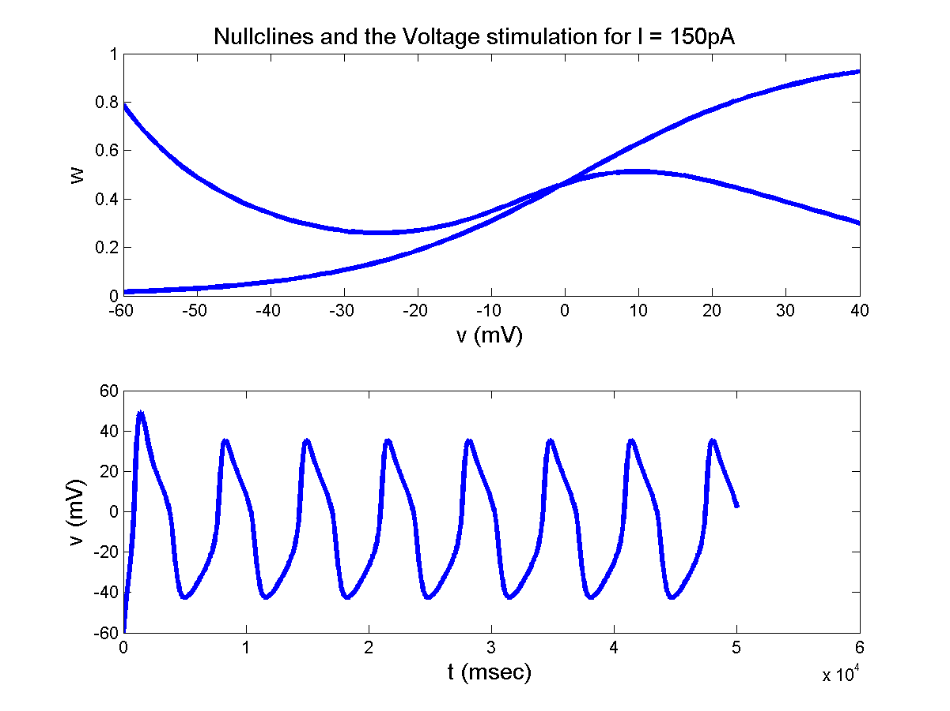
For Ia in the range (69-217 pA): the intersection point is in the middle branch.
Therefore, the ML model produces limit cycle oscillations.

Slide 49
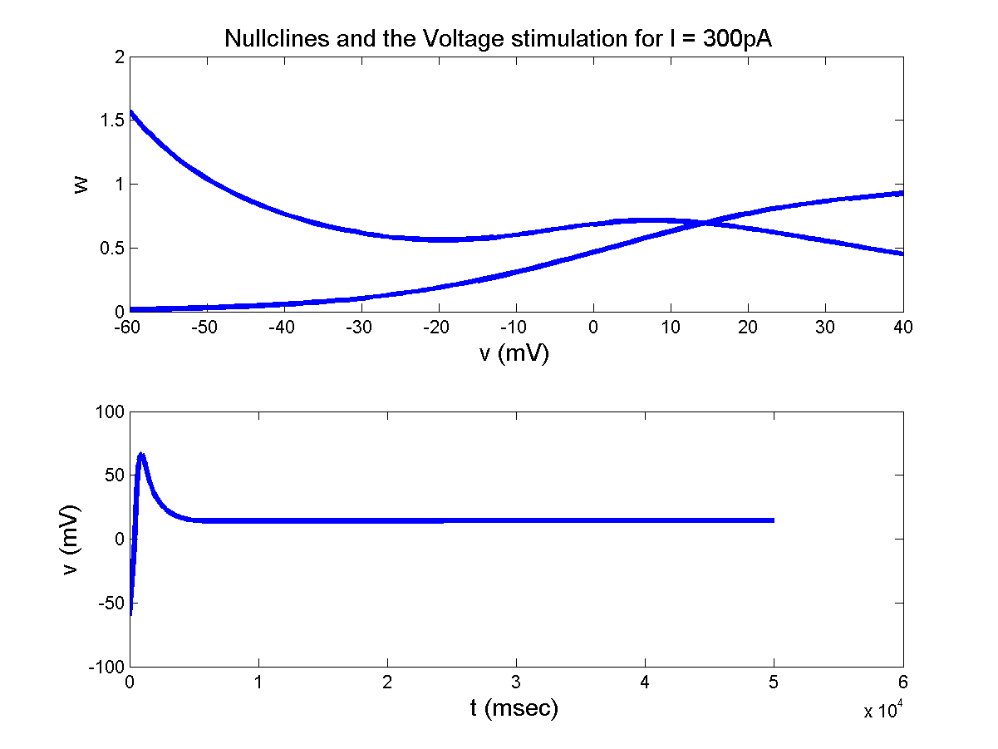
For Ia in the range (218 pA- ): the intersection point is in the right branch.
Therefore, the membrane voltage exhibits depolarization.

Slide 50
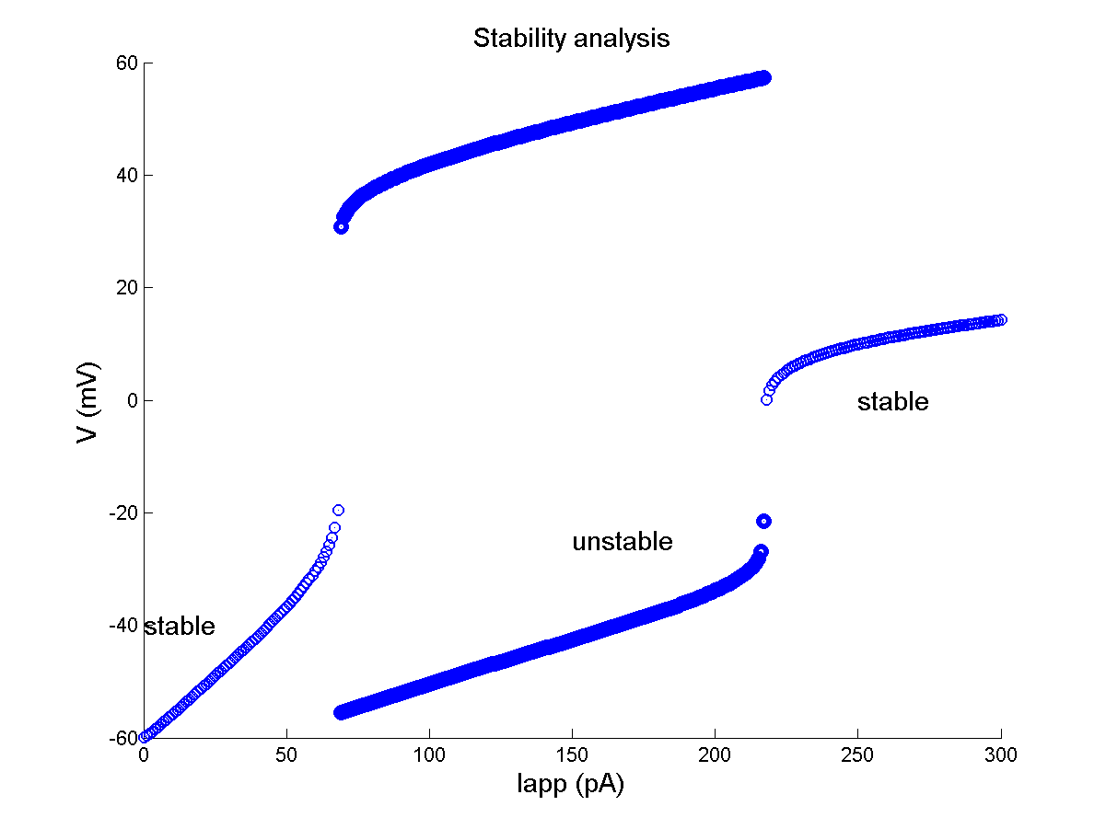

Slide 51
I Na P Model
So far we have visited two simplified neuron models that are capable of exhibiting some of the basic dynamic properties of a neuron: resting state, oscillations and depolarization.
Both the models are 2-variable systems which are preferred since they can be studied conveniently using phase-plane techniques.

Slide 52
The FitzHugh-Nagumo model was reduced systematically and derived from the HH model, whereas the Morris-Lecas model is slightly different from the HH model.
Let us now consider another model that is constructed by systematic reduction from the HH model.

Slide 53
This reduced model, known as the Ina,p + IK model has a persistent sodium channel (see chapter) and a potassium channel.
The “persistent” sodium channel,has only an activation variable; there is no inactivation variable.
The potassium channel also has a single activation variable.

Slide 54
Membrane voltage dynamics of such a model can be written as usual in the following form:

Slide 55
If we assume that ‘m’ dynamics is fast, we replace m in eqn. (*) above with and eliminate the ‘m’ dynamics (eqn. (**)).
We are now left with the following two equations:

Slide 56
Thus, the parameters for are: V_{1/2} = -20 mV and l = 15,
And the parameters for n-dynamics are, V_{1/2} = -25 mV and l = 5. t_{n}(V) = 1 for all V.

Slide 57
Rewriting eqns. (**) above, we may express the V- and n- null-clines as follows:
V-nullcine:
n-nullcline:

Slide 58
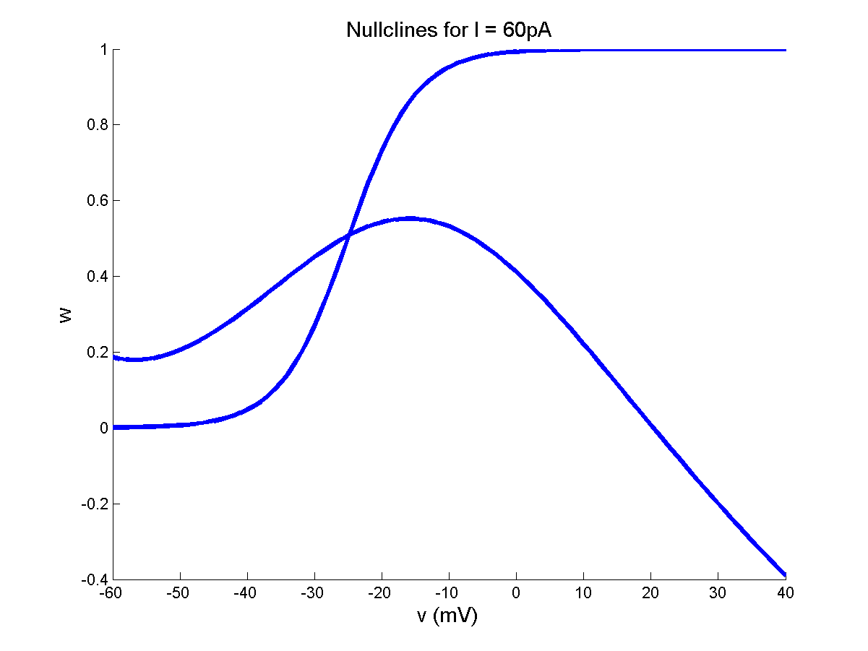
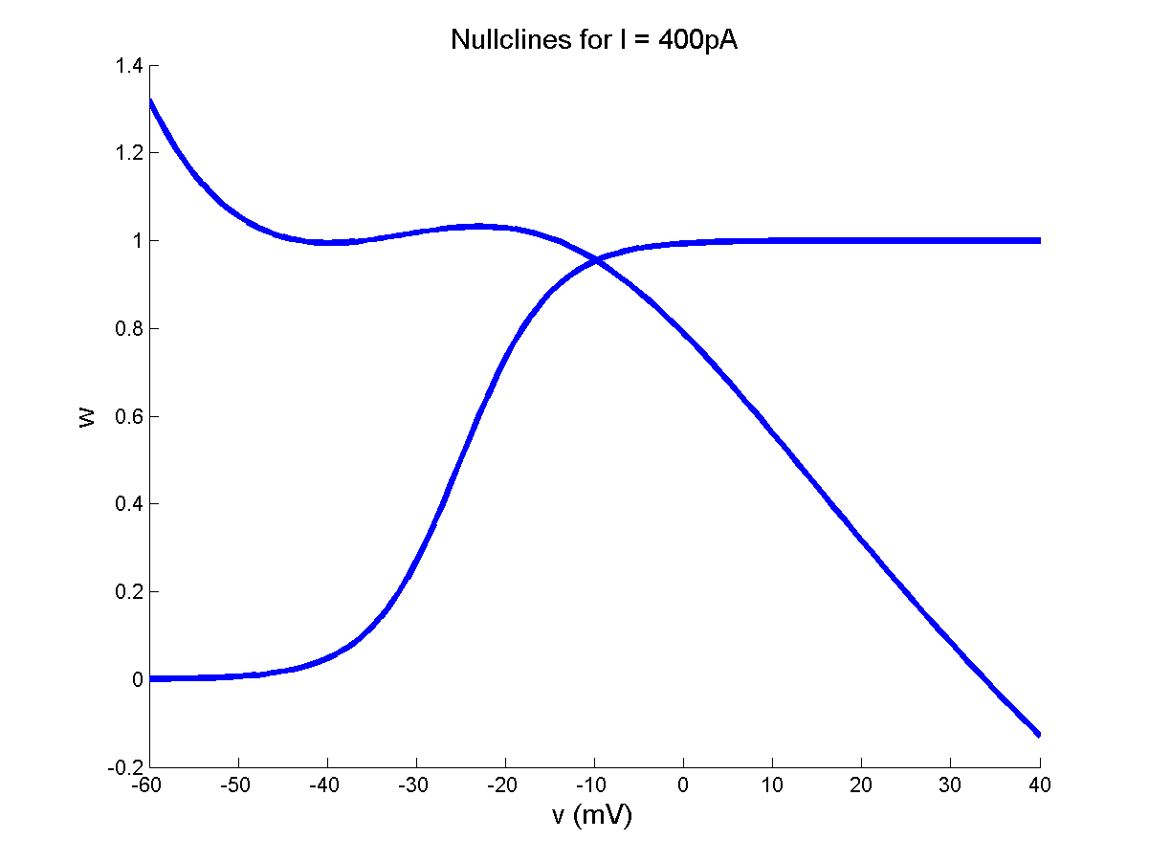
The V- and n-nullclines obtained from the above equations are shown.

